Slide 1
BITS Pilani presentation
K.Anantharaman
Faculty CS Department
kanantharaman@wilp.bits-pilani.ac.in
03-10/02/24
S2-23 SE ZG544 Agile Software Process

Slide 2
SE ZG544 , Agile Software Process
Lecture No. 4 - Agile Methodologies
03-10/02/24
S2-23 SE ZG544 Agile Software Process

Slide 3
Agenda
Agile Methodologies
Scrum
XP
Lean Software Development
Kanban
Value Stream Mapping
03-10/02/24
S2-23 SE ZG544 Agile Software Process

Slide 4
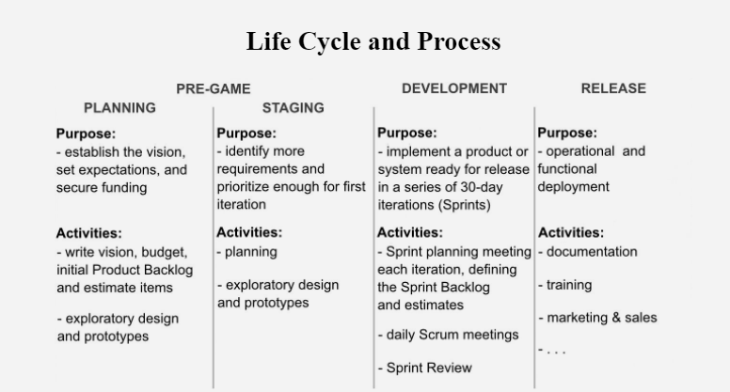
Scrum Life Cycle Process
Ref: So, What's The Big Deal About Scrum?,by by André Akinyele,2019
03-10/02/24
S2-23 SE ZG544 Agile Software Process

Slide 5

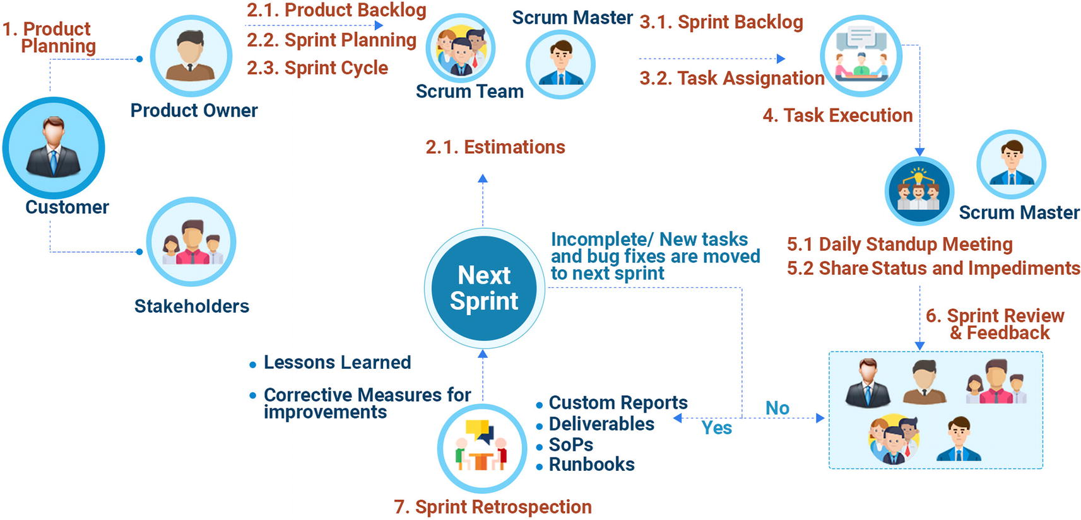
Scrum Model: Flow, Artifacts, Roles and Responsibilities
Product Backlog User Stories
Sprint | Start | End
1 | 20 | 15
2 | 15 | 11
3 | 11 | 5
4 | 7
Source: Hands-On Guide to AgileOps: A Guide to Implementing Agile, DevOps, and SRE for Cloud Operations By Navin Sabharwal, Raminder Rathore, Udita Agrawal
03-10/02/24
S2-23 SE ZG544 Agile Software Process

Slide 8
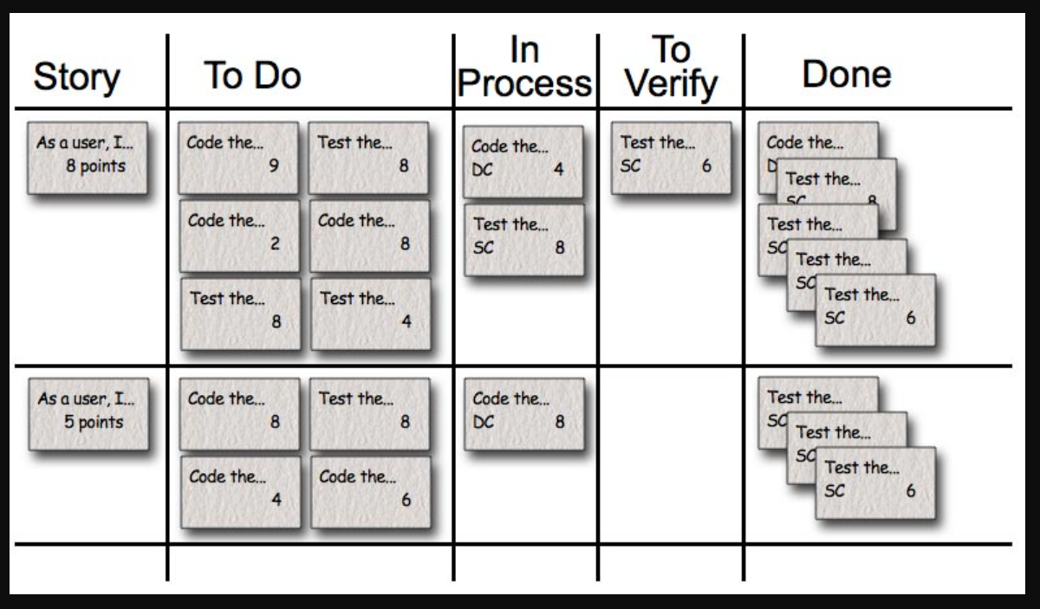
Progress Tracking - Scrum Task Board
Ref: Agile Estimating and Planning by Mike Cohn Published by Addison-Wesley Professional, 2005
03-10/02/24
S2-23 SE ZG544 Agile Software Process

Slide 9
Q&A

Slide 10
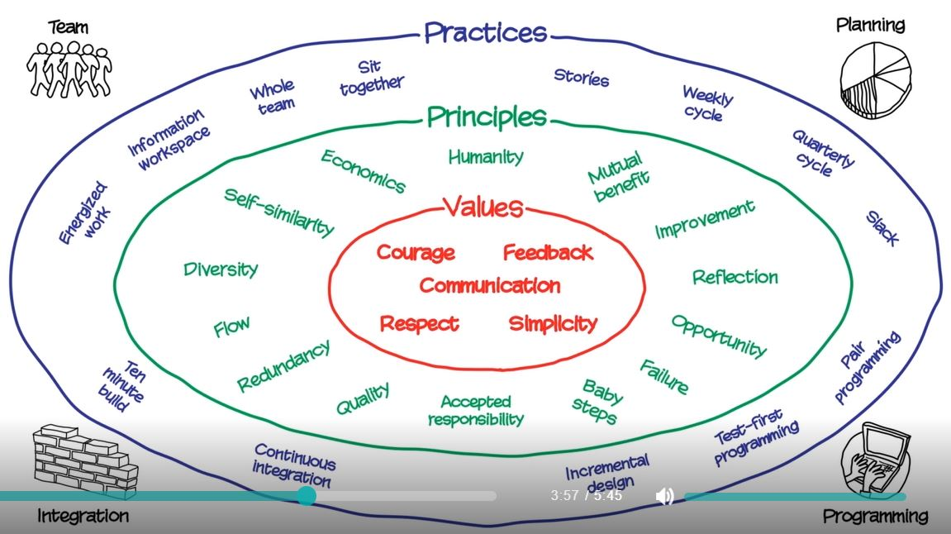
eXtreme Programming
(XP)
( Similar to Scrum Model with some differences)
Ref :Agile Sketchpad By Dawn Griffiths and David Griffiths
03-10/02/24
S2-23 SE ZG544 Agile Software Process

Slide 11
XP Practices
Test-Driven Development
Refactoring
Pair Programming
10-Minutes Build
Continuous Integration
03-10/02/24
S2-23 SE ZG544 Agile Software Process

Slide 12
Scrum & XP Differences
Focus:
Scrum: Project Management Framework
XP: Engineering Practices & Techniques
Roles and Responsibilities:
Scrum: Scrum defines specific roles such as Product Owner, Scrum Master, and Development Team.
XP: Encourages collective ownership
Iterations and Releases:
SCRUM: 1 to 4 weeks iteration
XP: 1 week iteration, prefer shorter time scales.
Engineering Practices:
Scrum: No prescribed Engineering Practices.
XP: Extreme Programming (XP) promotes a set of engineering practices designed to ensure high-quality software, including Test-Driven Development (TDD), Pair Programming, Continuous Integration, Refactoring, and Simple Design.
03-10/02/24

Slide 13
Q&A

Slide 14
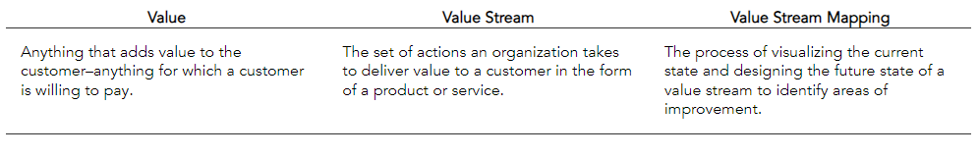
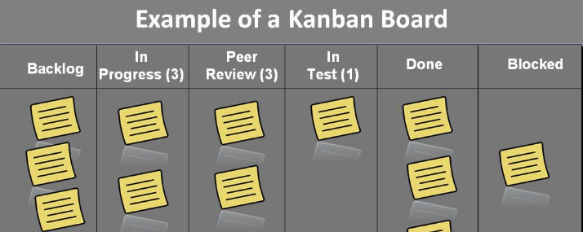
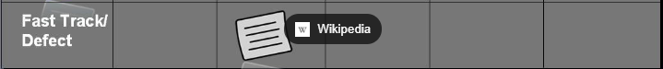
What is Lean Software Development? & Seven Principles of Lean
Lean is a systematic method to eliminate waste and maximize the flow of value through a system. Value is defined as something your customer will pay money for.
1. Eliminate Waste
2. Build Quality In
3. Create Knowledge
4. Defer Commitment
5. Deliver Fast
6. Respect People
7.Optimize the Whole
Value Stream Mapping
Kanban
Ref: What is Value Stream Mapping? Utilizing Value Streams | Planview
03-10/02/24
S2-23 SE ZG544 Agile Software Process

Slide 15
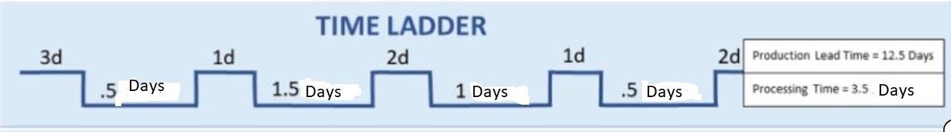
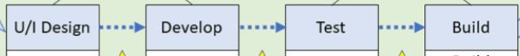
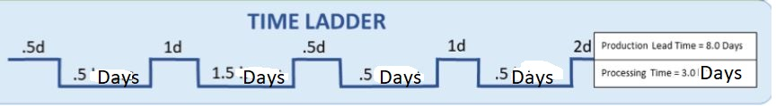
Value Stream Mapping
Current State
SharePoint
Excel
Wait
Work
Start
Lead time
End
Future State
Single Tool
Wait
Work
Process Efficiency = Cycle time/Lead Time * 100
Current State: 3.5/(12.5)*100 = 28%; Future state: 3/(8)*100 = 37.5%
Ref: https://www.plutora.com/blog/value-stream-mapping
03-10/02/24
S2-23 SE ZG544 Agile Software Process

Slide 16
Kanban
Kanban is a popular framework used to implement agile and DevOps software development. It requires real-time communication of capacity and full transparency of work
Kanban is not an Agile software development method (or process) or a software engineering methodology
Kanban is flow based methodology and a pull system.
Kanban does not prescribe specific roles or process steps as it is built on the concept of evolutionary change.
03-10/02/24
S2-23 SE ZG544 Agile Software Process

Slide 17
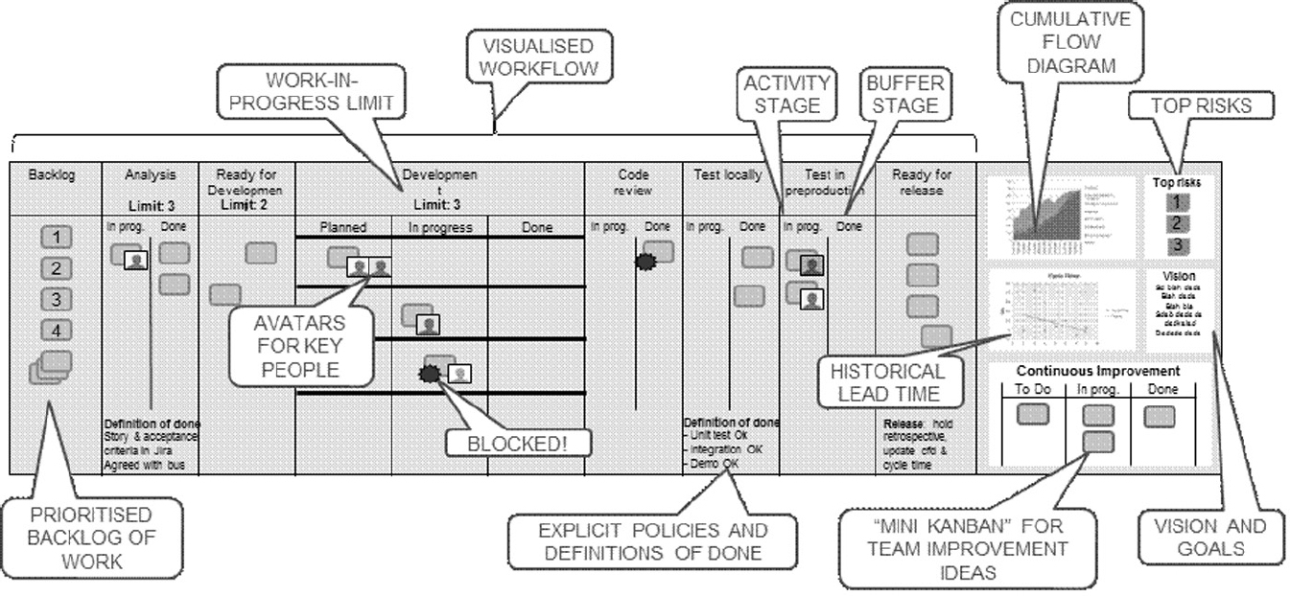
Typical Kanban Board
1
2
4
3
Feedback Loop
Manage flow
5
Source: Agile Foundations - Principles, practices and frameworks, by Peter Measey
Published by BCS Learning & Development Limited, 2015
03-10/02/24
S2-23 SE ZG544 Agile Software Process

Slide 18
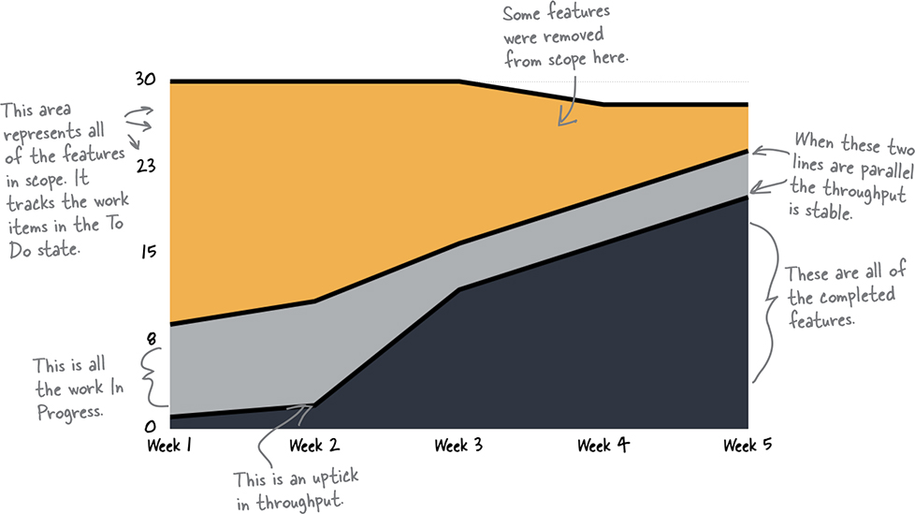
Cumulative flow diagram (Example-1)
Kanban teams use cumulative flow diagrams (or CFDs) to find out where they are systematically adding waste and interrupting their flow.
Source: Head First Agile by Jennifer Greene; Andrew Stellman,
Published by O'Reilly Media, Inc., 2017
03-10/02/24
S2-23 SE ZG544 Agile Software Process

Slide 19
Q&A

Slide 20
Common challenges faced in Scrum, XP, Lean, and Kanban methodologies (This is not an exhaustive list)
Methodology | Common Challenges | Possible Solutions
Scrum | Incomplete Backlog Items | Backlog grooming, stakeholder collaboration
 | Scope Creep | Stable sprint backlog, focus on sprint goal
 | Overcommitting | Realistic planning, consider team capacity
XP | Resistance to Pair Programming | Training, emphasize benefits of pair programming
 | Lack of Test Automation | Integrate TDD, provide testing tools
 | Continuous Integration Challenges | Regular CI/CD process review, automated deployment
Lean | Identifying Waste | Value stream mapping, eliminate non-value-added tasks
 | Lack of Cross-Functional Collaboration | Cross-functional teams, open communication
 | Limited Customer Involvement | Regular feedback sessions, user testing
Kanban | Work Overload | Set WIP limits, prioritize completion over new tasks
 | Unclear Workflow | Define visual workflow, optimize and communicate
 | Managing Blocked Items | Promptly identify and resolve blocked items

Slide 21
Module-4 - Agile Methodologies – Additional Notes
03-10/02/24
S2-23 SE ZG544 Agile Software Process

Slide 22
Scrum
History and Origins
Scrum is a single-team process framework used to manage product development.
Empirical process framework
Empirical method : A process how you think something works, test it out, reflect on the experience, and make the proper adjustments
Inspection, Adaption, Transparency
Based on adaptive life cycle method (Iterative and Incremental)
Scrum is the most common approach to agile for good reasons:
The rules of Scrum are straightforward and easy to learn and teams all around the world have been able to adopt them and improve their ability to deliver projects.
Using Scrum effectively is not so simple
03-10/02/24
S2-23 SE ZG544 Agile Software Process

Slide 23
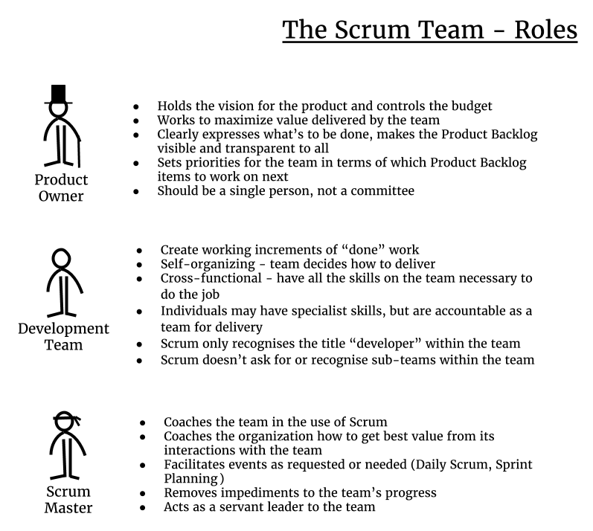
Scrum Roles
Ref: The Agile Developer's Handbook, by Paul Flewelling,Published by Packt Publishing, 2018
03-10/02/24
S2-23 SE ZG544 Agile Software Process

Slide 24
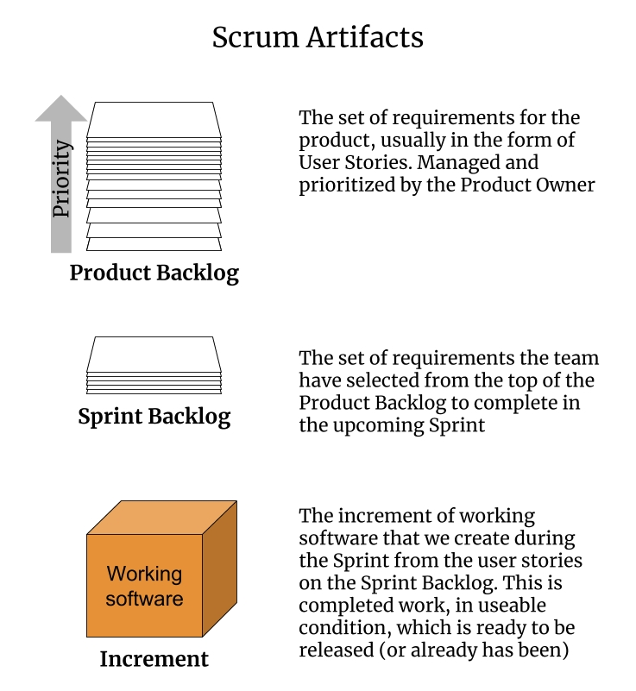
Scrum Artifacts
Ref: The Agile Developer's Handbook, by Paul Flewelling,Published by Packt Publishing, 2018
03-10/02/24
S2-23 SE ZG544 Agile Software Process

Slide 25
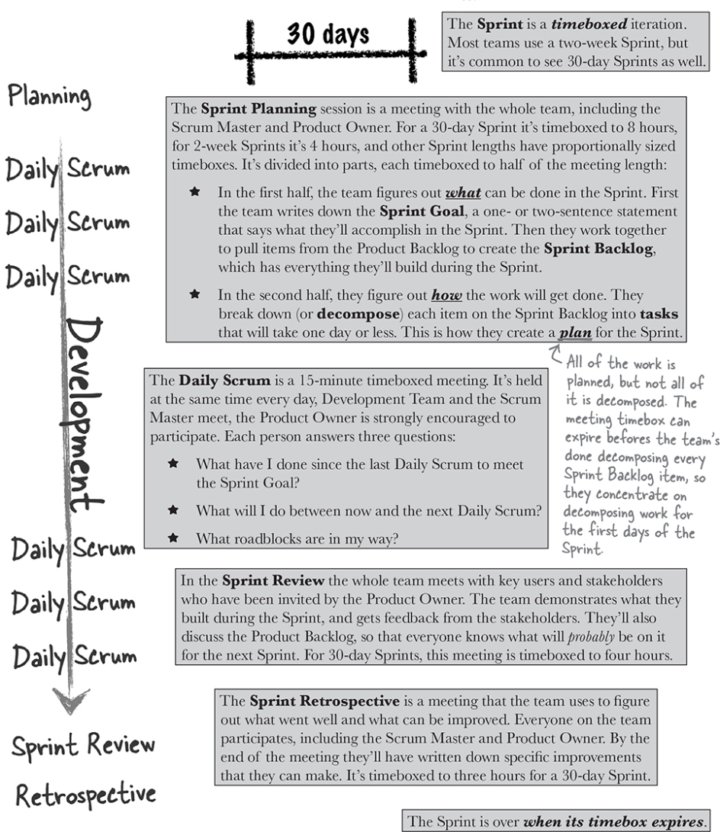
Sprint Events/Ceremonies
2 wks. to 4wks.
Ref: Head First Agile by Jennifer Greene; Andrew Stellman,
Published by O'Reilly Media, Inc., 2017
03-10/02/24
S2-23 SE ZG544 Agile Software Process

Slide 26
XP- Extreme Programming
References: Agile Foundations - Principles, practices and frameworks, by Peter Measey
Published by BCS Learning & Development Limited, 2015
Scaling Software Agility: Best Practices for Large Enterprises by Dean Leffingwell
Published by Addison-Wesley Professional, 2007
03-10/02/24
S2-23 SE ZG544 Agile Software Process

Slide 27
What is eXtreme Programming?
XP is a widely used agile software development method developed by Ken Beck,2000.
Key Practices:
A team of five to 10 programmers work at one location with customer representation on site.
Development occurs in frequent builds or iterations, each of which is releasable and delivers incremental functionality.
Requirements are specified as user stories, each a chunk of new functionality the user requires.
Programmers work in pairs, follow strict coding standards, and do their own unit testing.
Requirements, architecture, and design emerge over the course of the project.
XP is prescriptive in scope. It is best applied to small teams of under 10 developers, and the customer should be either integral to the team or readily accessible
What is Extreme?
– Practices are to its purest, simplest form, P-Programming- innovative and sometimes controversial practices for the actual writing of software.
03-10/02/24
S2-23 SE ZG544 Agile Software Process

Slide 28
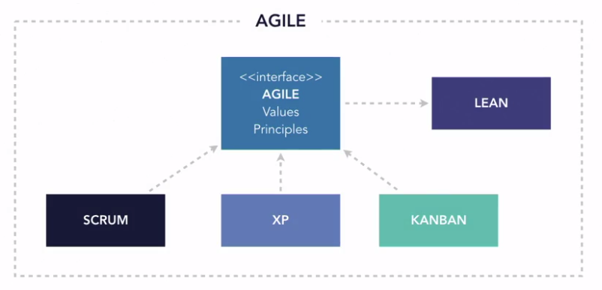
How XP fits in Agile
Source :LinkedIn Learning/XP overview
03-10/02/24
S2-23 SE ZG544 Agile Software Process

Slide 29
XP Theme
The primary theme of XP is that if something hurts, do it all the time.
If code reviews are good, we’ll review code all the time (pair programming).
If testing is good, everybody will test all the time (unit testing), even the customers (functional testing).
If design is good, we’ll make it part of everybody’s daily business (refactoring).
If simplicity is good, we’ll always leave the system with the simplest design that supports its current functionality (the simplest thing that could possibly work).
If architecture is important, everybody will work at defining and refining architecture all the time (metaphor).
If integration testing is important, we will integrate and test several times a day (continuous integration).
If short iterations are good, we will make the iterations really, really short—seconds and minutes and hours, not weeks and months and years.
The Extreme case!
Source :Lynda.com/XP overview
03-10/02/24
S2-23 SE ZG544 Agile Software Process

Slide 30
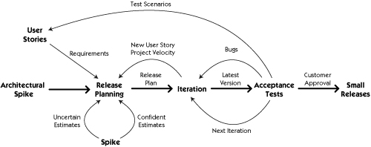
A visual process model for XP
03-10/02/24
S2-23 SE ZG544 Agile Software Process

Slide 31
XP Core Values
Communication (Key to Product Quality)
Planning, Estimation, Co-location, Pair-programming, Unit tests
Feedback (Ensures stay on course)
Short iterations, On-site customer, State of functional tests shows the current development of the project and unit tests shows state of the code base.
Simplicity(Simple design has least bugs and easy to modify
‘‘Do the simplest thing that could possibly work” philosophy, focusing on solutions for the current iterations of work and contribute to rapid development of stories.
No extra functionality.
Respect (Respect each other ideas we are creating together)
Respecting oneself and other team members in the team
Courage (It takes courage to do things you know are right)
It takes courage to highlight issues/Architecture flaw even late in the day, it takes courage to throw away the code when you recognize that there is a better design. takes courage to refactor the another developer code, Courage to fail. Change.
03-10/02/24
S2-23 SE ZG544 Agile Software Process

Slide 32
Basic XP principles
Humanity
XP’s first principle is the simple principle of humanity.
Focus on people, empower people, provide benefits to people, and you and your people are likely to find a way to a process that engages people in working together and solving problems in new and innovative ways.
Rapid feedback
Seek feedback at the earliest possible moment, interpret it appropriately and apply learning from it back into the system. In practice this is achieved by the different Planning, testing activities, direct communication with the customer ,sharing of knowledge and code across the whole team.
Assume simplicity
Choose the simplest solution that could solve the problem. By applying the principle of simplicity to development, design and code becomes leaner, resulting in quicker development.
The phrase ‘You Ain’t Gonna Need It’ (YAGNI) was coined to embody this principle., DRY (Don’t Repeat Yourselves)
03-10/02/24
S2-23 SE ZG544 Agile Software Process

Slide 33
XP Principles …
Incremental change/Baby Steps
Small manageable steps/tasks. Work incrementally, one/two week iterations
Embrace change
Quality work
An XP team is committed to the principle of doing a good job.
By producing quality work, members of an XP team will be proud of their contribution to the project, which becomes a motivating factor.
Sacrificing quality will only have a negative effect on a project. As one of the fundamental principles of XP, it should not be optional.
Reflection.
Retrospect and improve
03-10/02/24
S2-23 SE ZG544 Agile Software Process

Slide 34
Further principles
These principles are more specific to particular situations.
Teach learning
Small initial investment (Focus on innovation)
Play to win
Concrete experiments
Open and honest communication
Work with people’s instincts, not against them
Accepted responsibility
Local adaptation
Travel light
Honest measurement
03-10/02/24
S2-23 SE ZG544 Agile Software Process

Slide 35
Key XP Practices
The planning game:
Release planning: (Monthly or Quarterly)
User-stories, Customer responsibility, Stakeholders
Exploration phase (Elaboration, estimation – Whole Team activity)
Commitment phase (Based on the business value, combined with the estimates, the customer will decide the scope and date of the next release)
Steering phase (Weekly cycle - executed over the remaining time till release)
Feedback from each iteration’s delivery is used to steer the project. Both the customer and team have opportunities during the steering phase to make changes.
03-10/02/24
S2-23 SE ZG544 Agile Software Process

Slide 36
XP Practices
Small releases
Small releases can start to gather feedback that can be used in steering the system’s subsequent development, as well as potentially delivering business value early.
Metaphor
Used to form a form an understanding of the system by whole team through the project
Example: Shopping cart as metaphor to discuss e-Commerce application requirements.
Simple design
Testing
All stories are to have automated functional tests
Indications of progress as new tests are shown to be successful.
Confidence in the system as existing tests are shown to be successful.
Team is driven by tests , Test Driven development (TDD)
03-10/02/24
S2-23 SE ZG544 Agile Software Process

Slide 37
XP Practices …
Refactoring
Refactoring is the process of simplifying the internal structure of code without affecting its external behavior
TDD = Test first + Refactoring
Pair programming
Code is created by two developers using one machine.
When One person codes, other person in in different perspective - about the design, different solutions, how code fits into overall solutions.
After a period of time or at a convenient point, the developers swap places.
Benefits:
Conversation during the process helps to quickly move the solution on.
Knowledge is shared as developers pair with different individuals.
Code is reviewed in real-time; teams that practice pair programming often eschew code reviews.
The practice promotes collective code ownership.
03-10/02/24
S2-23 SE ZG544 Agile Software Process

Slide 38
XP Practices …
Collective ownership
Developers can improve any part of the code at any time.
This practice also avoids code becoming owned by individuals, which can lead to bottlenecks in development and poorly designed code.
Continuous integration
The codebase should be integrated and automated tests run frequently.
Developers working locally on their machines should check-in their changes frequently, ensuring that code conflicts are identified and resolved quickly.
10-Minute build
Build, Deploy and Test - all in 10 minutes
Build Server/Integration server – Builds the code automatically - pull the code from the source control system and compiles the integrated code, then deploy the code on a test/stage environment and run automated tests) Example: Jenkins integration server
Continuous integration is a practice of integrating the code several times a day
Having a build server/integration server alone is not continuous integration
03-10/02/24
S2-23 SE ZG544 Agile Software Process

Slide 39
XP Practices …
Forty-hour week (Energized work)
Teams aim for sustainable phase
XP does not forbid overtime, but it has a clear rule – You can’t work a second week of overtime.
On-site customer
A real customer should sit with the team.
This person will be someone who will use the system, who has the knowledge and authority to answer questions and who can provide business related clarification so that issues don’t block the progress of the iteration.
Coding standards
A common coding standard, agreed by all developers, must be adopted across the team.
Informative workspace (Information Radiator)
Visual board, Managers can assess status and see what people are working on by simply walking through the team area.
03-10/02/24
S2-23 SE ZG544 Agile Software Process

Slide 40
Test Driven Development (TDD)
03-10/02/24
S2-23 SE ZG544 Agile Software Process

Slide 41
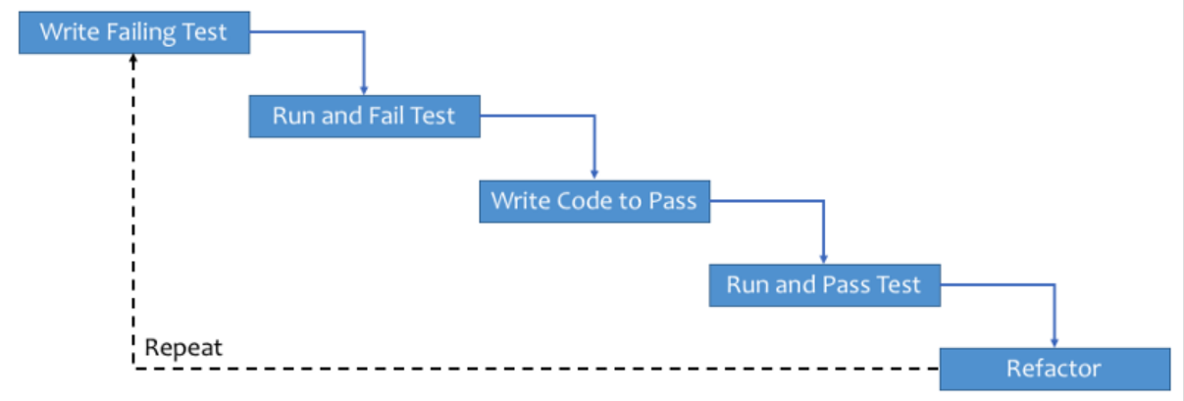
Test Driven Development-General work flow
A Process where the Developer takes responsibility of the Quality of their code
Unit tests are written before the production code.
Don’t write all tests at once
Tests and Production code are written in small bits of functionality
TDD is a XP process and created by Ken Buck.
https://www.freecodecamp.org/news/learning-to-test-with-python-997ace2d8abe/
03-10/02/24
S2-23 SE ZG544 Agile Software Process

Slide 42
Lean Software Development
03-10/02/24
Ref: Lynda.com :DevOps Foundations: Lean and Agile with Ernest Mueller and Karthik Gaekwad
S2-23 SE ZG544 Agile Software Process

Slide 43
What is Lean?
Lean is a systematic method to eliminate waste and maximize the flow of value through a system. Value is defined as something your customer will pay money for.
Lean employs something called Value stream mapping.
This practice is widely used in Manufacturing world.
03-10/02/24
S2-23 SE ZG544 Agile Software Process

Slide 44
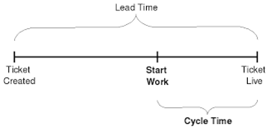
Lead time & Cycle Time
Lead time tracks the total amount of time it takes from when work is requested until it's delivered.
Cycle time tracks the amount of time we spend working on it. (Also called Processing time or Throughput time)
03-10/02/24
S2-23 SE ZG544 Agile Software Process

Slide 45
Value Stream Mapping
Value is defined as something your customer will pay money for.
Value Stream Mapping practice generates a diagram that shows the exact places where value is created in your system and how it flows through your organization.
03-10/02/24
S2-23 SE ZG544 Agile Software Process

Slide 46
7 Principles of Lean Software Development
03-10/02/24
S2-23 SE ZG544 Agile Software Process

Slide 47
1. Eliminate Waste
Type of waste in SW Development
Unnecessary code or functionality: Delays time to customer, slows down feedback loops
Starting more than can be completed: Adds unnecessary complexity to the system, results in context-switching, handoff delays, and other impediments to flow
Delay in the software development process: Delays time to customer, slows down feedback loops
Unclear or constantly changing requirements: Results in rework, frustration, quality issues, lack of focus
Bureaucracy: Delays speed
Slow or ineffective communication: Results in delays, frustrations, and poor communication to stakeholders which can impact IT’s reputation in the organization
03-10/02/24
S2-23 SE ZG544 Agile Software Process

Slide 48
2. Build Quality In
Pair programming: Avoid quality issues by combining the skills and experience of two developers instead of one
Test-driven development: Writing criteria for code before writing the code to ensure it meets business requirements
Incremental development and constant feedback
Minimize wait states: Reduce context switching, knowledge gaps, and lack of focus
Automation: Automate any tedious, manual process or any process prone to human error
03-10/02/24
S2-23 SE ZG544 Agile Software Process

Slide 49
3. Create Knowledge
Pair Programming
Code reviews
Documentation
Wiki – to let the knowledge base build up incrementally
Chat, Chatops
Thoroughly commented code
Knowledge sharing sessions
Training
Use tools to manage requirements or user stories
03-10/02/24
S2-23 SE ZG544 Agile Software Process

Slide 50
4. Defer Commitment
Don’t make decision/commit if you can differ it at later point in time. Keep options open.
Continuously collect and analyze the data or information
03-10/02/24
S2-23 SE ZG544 Agile Software Process

Slide 51
5. Deliver Fast
Build a simple solution.
Put it in front of customers
Enhance incrementally based on customer feedback.
Speed to market is an incredible competitive advantage esp. for Software.
What slows them down?
Thinking too far in advance about future requirements
Blockers that aren’t responded to with urgency
Over-engineering solutions and business requirements
03-10/02/24
S2-23 SE ZG544 Agile Software Process

Slide 52
6. Respect People
Communicating proactively and effectively
Encouraging healthy conflict
Surfacing any work-related issues as a team (Blameless postmortem)
Empowering each other to do their best work.
03-10/02/24
S2-23 SE ZG544 Agile Software Process

Slide 53
7.Optimize the Whole
Value Stream mapping
System thinking
Operating with a better understanding of capacity and the downstream impact of work.
03-10/02/24
S2-23 SE ZG544 Agile Software Process

Slide 54
Lean Principles that are Proven to Work
Small deliverables
Limiting work in progress
Information radiators and visibility into flow,
Gathering, broadcasting and implementing customer feedback
Empowered development teams who are free to experiment and improve.
03-10/02/24
S2-23 SE ZG544 Agile Software Process

Slide 55
Kanban
03-10/02/24
S2-23 SE ZG544 Agile Software Process

Slide 56
Kanban
Taiichi Ohno, who was an industrial engineer at Toyota, developed the Kanban methodology in 2004 to improve efficiency at the manufacturing plant.
The Kanban method is an approach to continuously improving service delivery that emphasizes the smooth, fast flow of work.
Kanban is not an Agile software development method (or process) or a software engineering methodology
Kanban is flow based methodology and a pull system.
Kanban does not prescribe specific roles or process steps as it is built on the concept of evolutionary change.
03-10/02/24
S2-23 SE ZG544 Agile Software Process

Slide 57
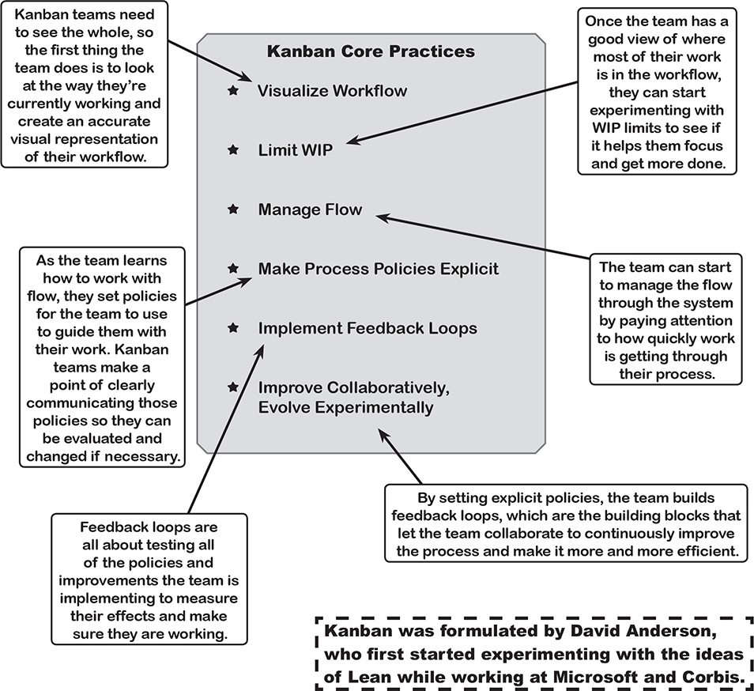

03-10/02/24
S2-23 SE ZG544 Agile Software Process

Slide 58
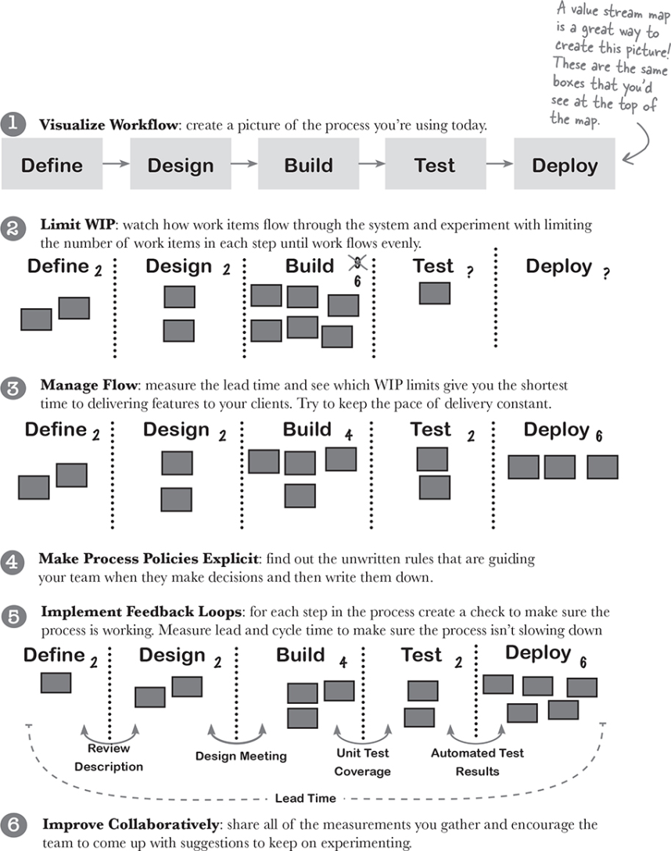
How to use Kanban to improve your process
Ref: Head First Agile by Jennifer Greene; Andrew Stellman,
Published by O'Reilly Media, Inc., 2017
03-10/02/24
S2-23 SE ZG544 Agile Software Process

Slide 59
Typical Kanban board
Ref: Agile Foundations - Principles, practices and frameworks, by Peter Measey
Published by BCS Learning & Development Limited, 2015
03-10/02/24
S2-23 SE ZG544 Agile Software Process

Slide 60
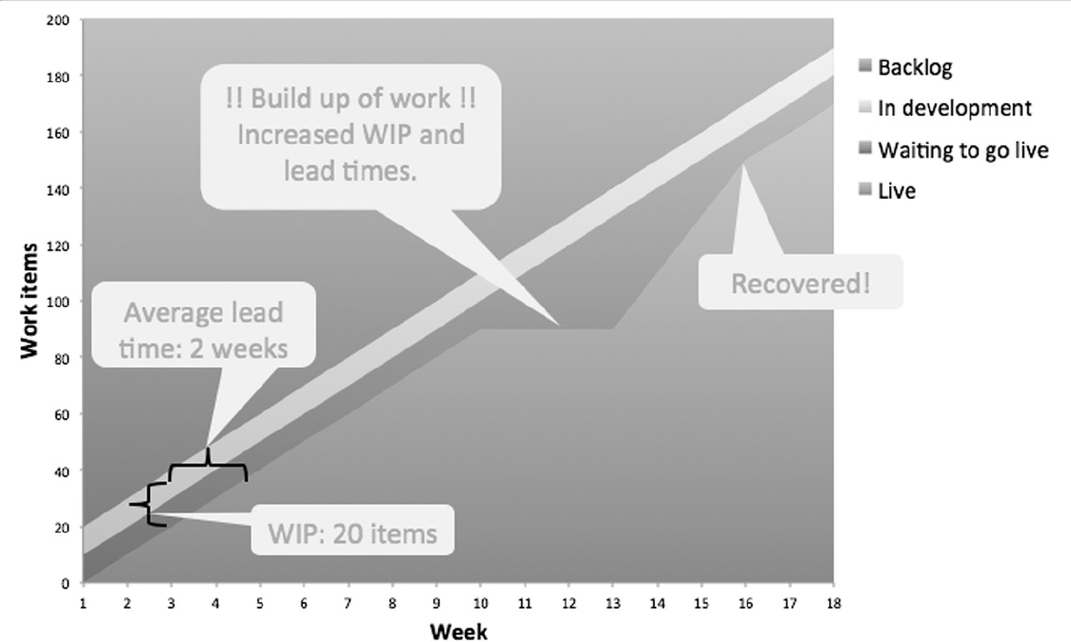
Cumulative flow diagram (Example-2)
Ref: Agile Foundations - Principles, practices and frameworks, by Peter Measey
Published by BCS Learning & Development Limited, 2015
03-10/02/24
S2-23 SE ZG544 Agile Software Process

Slide 61
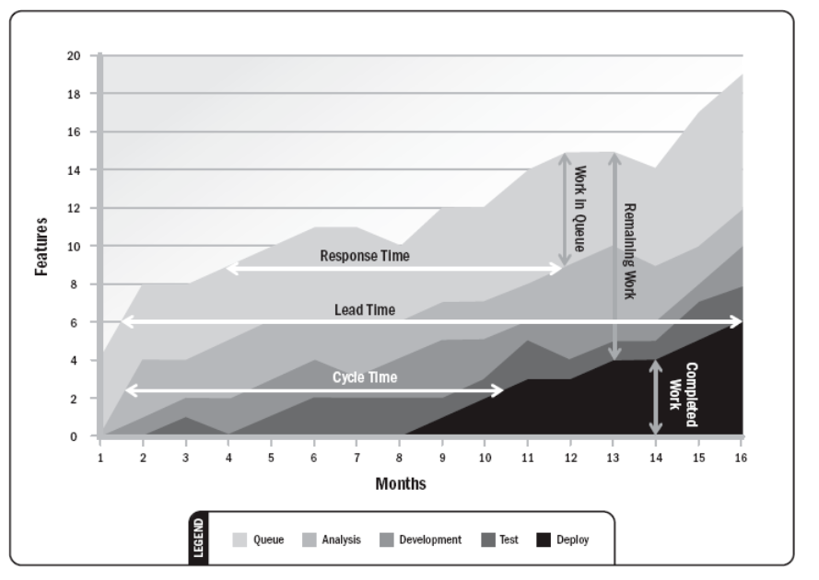
Cumulative flow diagram (Example-3)
03-10/02/24
S2-23 SE ZG544 Agile Software Process

Slide 62
Module-4 XP-Technical Practices
03-10/02/24
S2-23 SE ZG544 Agile Software Process

Slide 63
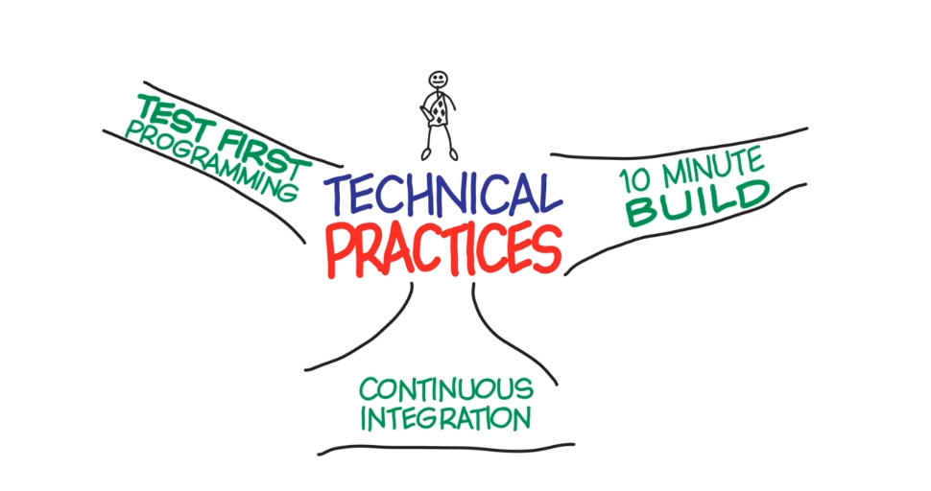
XP-Technical Practices
TDD: Write tests before you write the code
Find any new problem as quickly as possible.(within 10 minutes)
Build, Deploy, Test
This is a process of building, deploying and testing all the time. (Many times a day)
03-10/02/24
S2-23 SE ZG544 Agile Software Process
Source: The Agile Sketchpad Dawn Griffiths David Griffiths

Slide 64
TDD Helps You Avoid Scope Creep
Scope Creep:
One common reason why scope creep occurs is lack of documentation with clearly defined requirements.
This problem can be mitigated through test driven development.
In a TDD environment, developers write unit tests to test particular segments ‒ units ‒ of code. Unit tests serve as specifications that describe the precise features that should be implemented.
Therefore, well-specified tests prevent developers from writing superfluous code.
TDD helps developers focus on what’s necessary and prevents gold plating ‒ adding unnecessary or unwanted features that weren’t specified in the project requirements.
03-10/02/24
S2-23 SE ZG544 Agile Software Process

Slide 65
TDD can serve as living documentation
Code comments can get out of date , but the automated tests should be up-to-date, otherwise the tests will break the code. By looking at the test we can infer what the code supposed to do
Tests can serve as documentation to a developer. If you're unsure of how a class or library works, go and have a read through the tests.
03-10/02/24
S2-23 SE ZG544 Agile Software Process

Slide 66
TDD Can Lead to Better Design
A good test suite allows you to refactor, which allows you to improve your design over time.
The TDD cycle is very detail-oriented and requires you to make some design decisions when writing tests, rather than when writing production code. I find this helps to think about design issues more deeply.
TDD makes some design problems more obvious.
Using automated tests, code needs to work with the rest of the application and also with unit tests. The chances are the code can be reused elsewhere in your system.
If you have difficulty in writing tests for the code, the changes are the code need to redesign.
03-10/02/24
S2-23 SE ZG544 Agile Software Process

Slide 67
TDD helps in Drive Progress
One of the fundamental ideas behind the concept of test-first development is to let the tests show you what to implement in order to make progress on developing the software.
You’re not just coding away, oblivious to the requirements of the piece of code you’re writing. You’re satisfying an explicit, unambiguous requirement expressed by a test. You’re making progress, and you’ve got a passing test to show for it.
Forced to make the code to perform something useful because the tests are passed.
03-10/02/24
S2-23 SE ZG544 Agile Software Process

Slide 68
Unit and Acceptance Tests
Unit tests are written by programmers to ensure that the code does what they intend it to do.
Acceptance tests are written by business people (and QA) to make sure the code does what they intend it to do
03-10/02/24
S2-23 SE ZG544 Agile Software Process

Slide 69
10-Minute Build
One of the practices recommended by Extreme Programming (XP) is to keep a ten-minute build. Kent Beck and Cynthia Andres write in Extreme Programming Explained (Second Edition):
"Automatically build the whole system, Deploy and run all of the tests in ten minutes. A build that takes longer than ten minutes will be used much less often, missing the opportunity for feedback."
03-10/02/24
S2-23 SE ZG544 Agile Software Process

Slide 70
Continuous Integration
Continuous Integration (CI) is a development practice that requires developers to integrate code into a shared repository several times a day. Each check-in is then verified by an automated build, allowing teams to detect problems early.
By integrating regularly, you can detect errors quickly, and locate them more easily
03-10/02/24
S2-23 SE ZG544 Agile Software Process

Slide 71
Thank you
03-10/02/24
S2-23 SE ZG544 Agile Software Process

